Slide 1
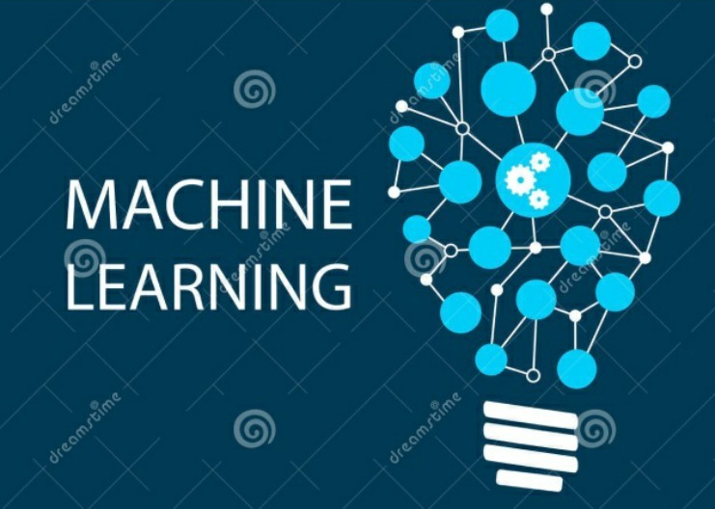
Machine Learning Dimensionality Reduction
Prof.Shuyuan Yang, Zhixi Feng
E-mail： syyang@xidianedu.cn
zxfeng@xidian.edu.cn

Slide 2

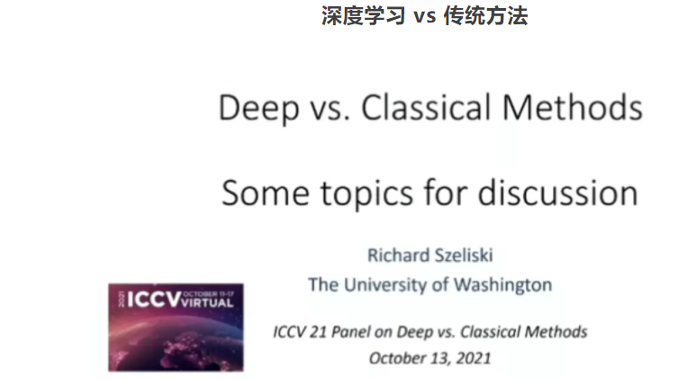
我们是否应该讲授深度学习之前的传统方法？还是直接通过深度学习解决所有的问题？
A discussion about deep learning vs classical methods and their roles in computer vision
Aude Oliva（MIT-IBM Watson 人工智能实验室）、Svetlana Lazebnik（伊利诺伊大学香槟分校）、Jitendra Malik（加州大学伯克利分校）、Andrew Davison（帝国理工大学）、Richard Szeliski（华盛顿大学）、Alexei Efros（加州大学伯克利分校）。

Slide 3
Contents
Dataset
Preprocessing
Dimensionality Reduction

Slide 4
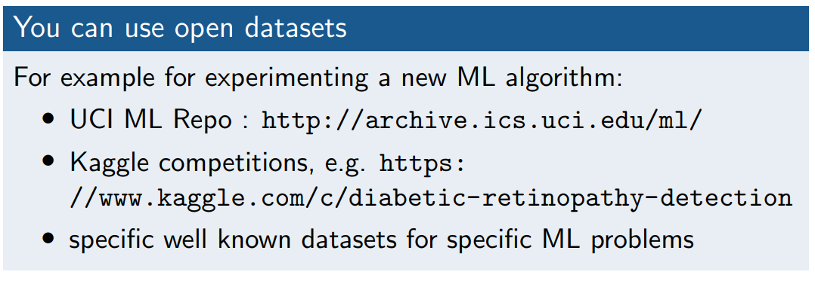
You need datasets

Slide 5
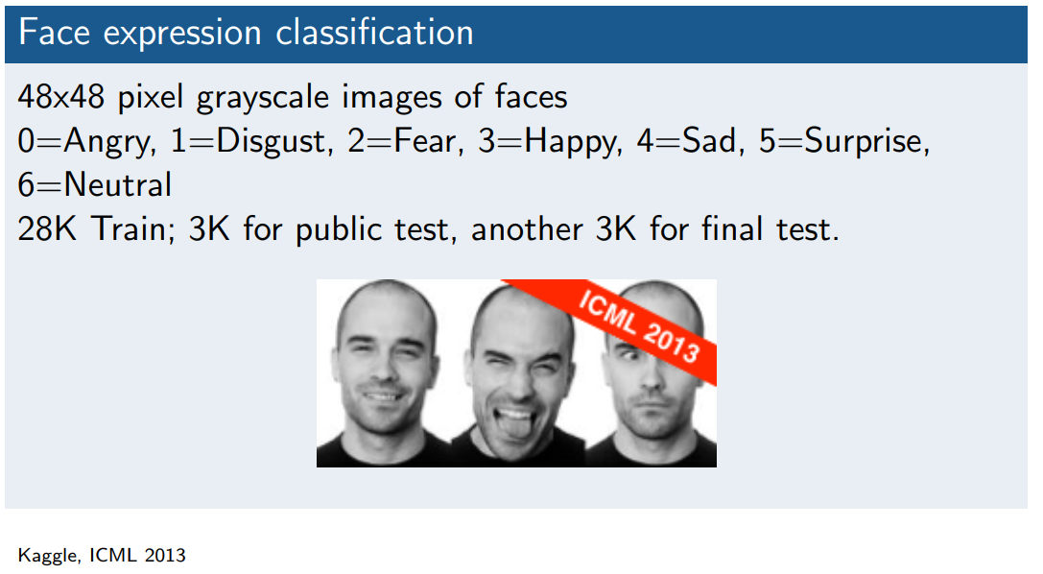
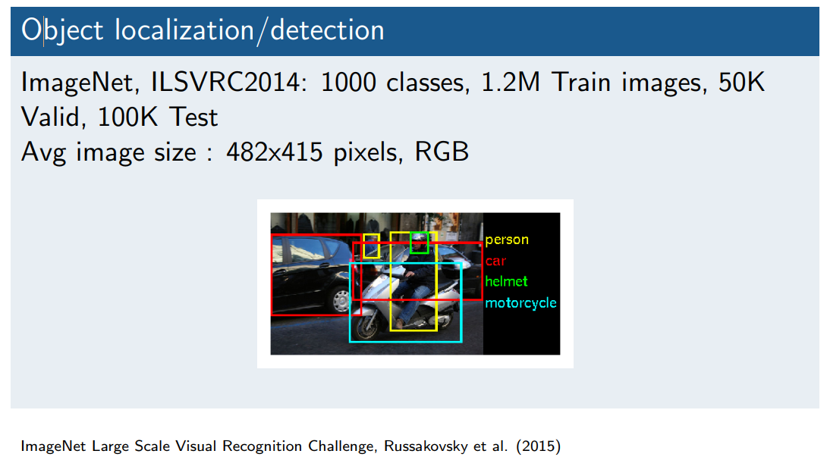
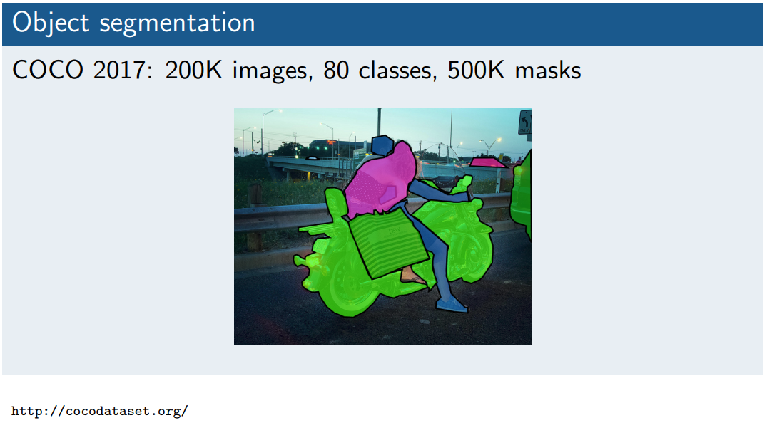
Some available datasets

Slide 6
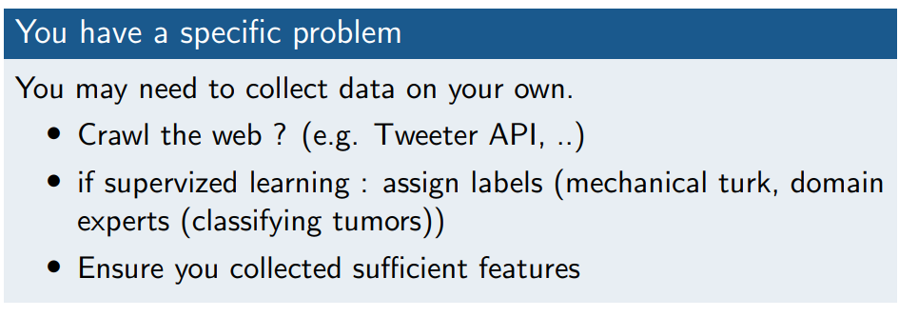
You need datasets ！！

Slide 7
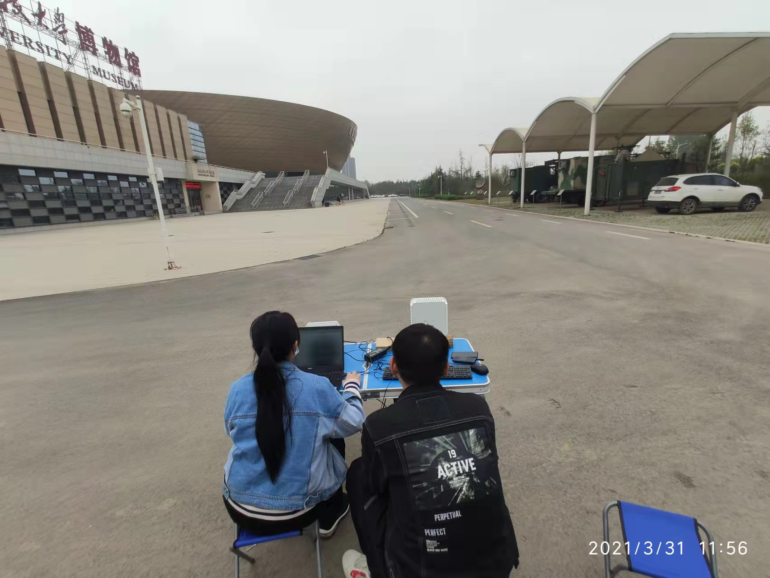

You need datasets ！！

Slide 8
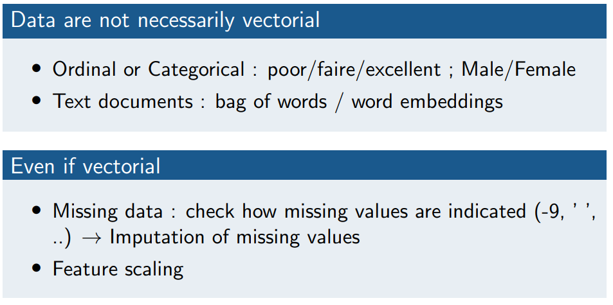
Preprocessing data

Slide 9
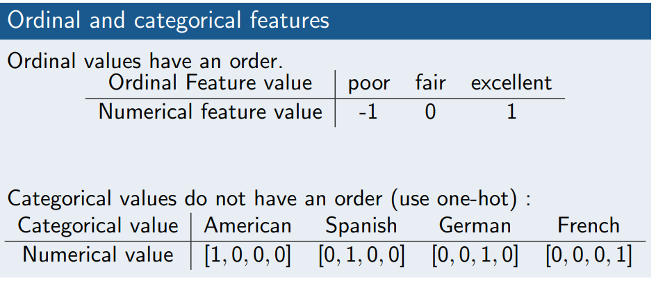
Preprocessing data
Your data might not be vectorial data

Slide 10
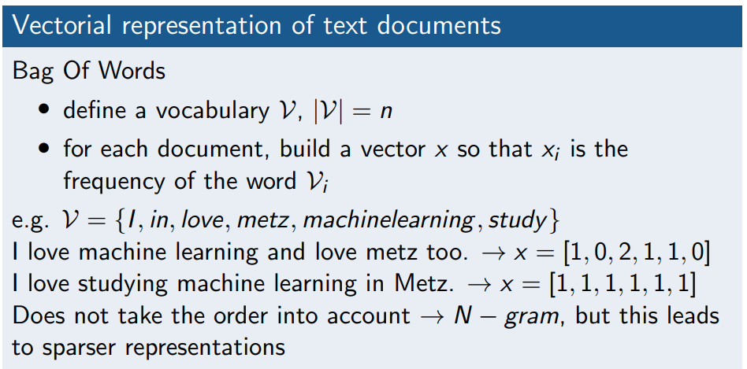
Preprocessing data

Slide 11
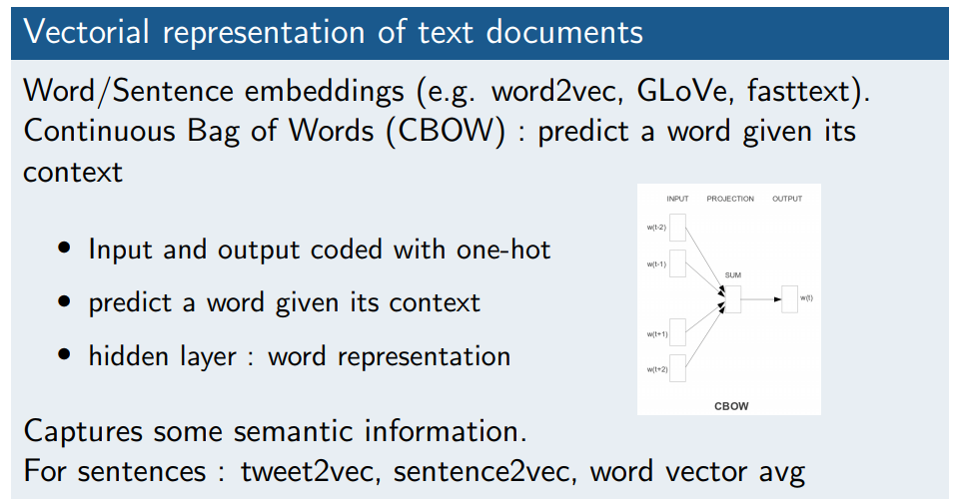
Preprocessing data

Slide 12
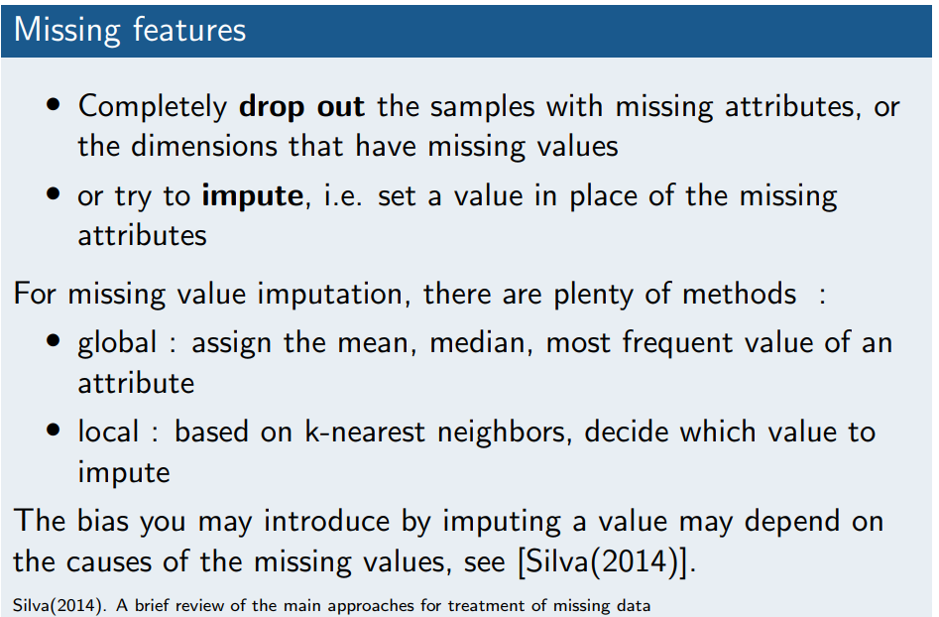
Preprocessing data
Some features might be missing

Slide 13
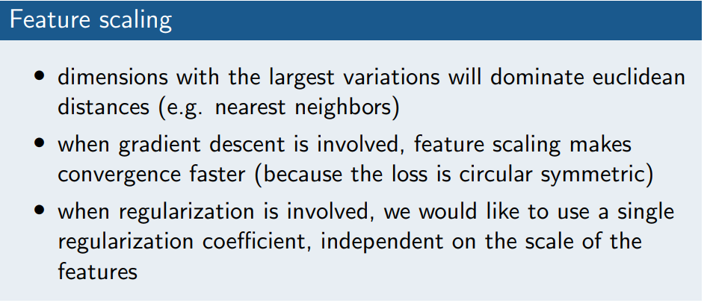
Preprocessing data
Some vectorial data might not be appropriately scaled

Slide 14
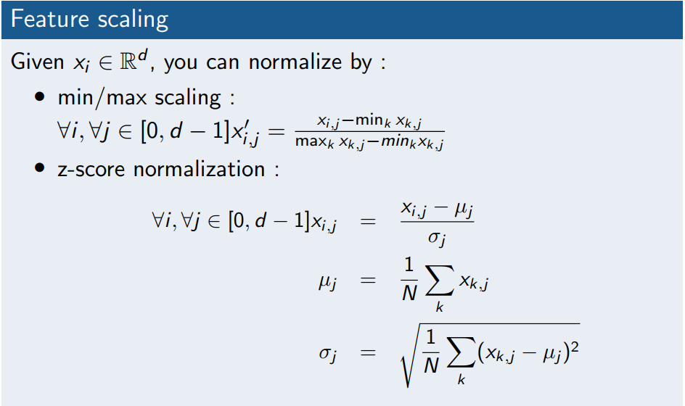
Preprocessing data
Your statistics must be computed from the training set and applied also to test data

Slide 15
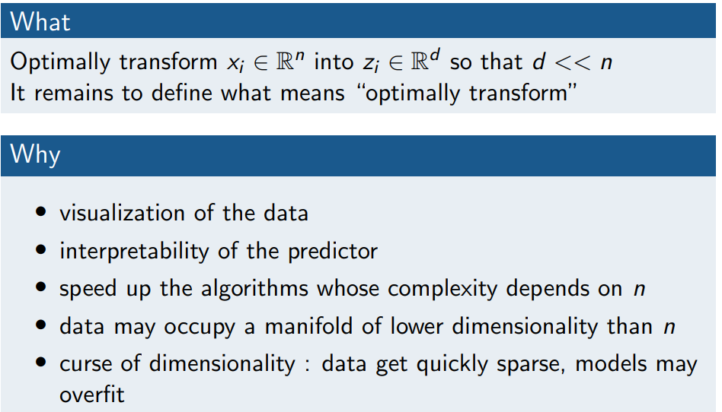
Dimensionality reduction : what/why/how

Slide 16
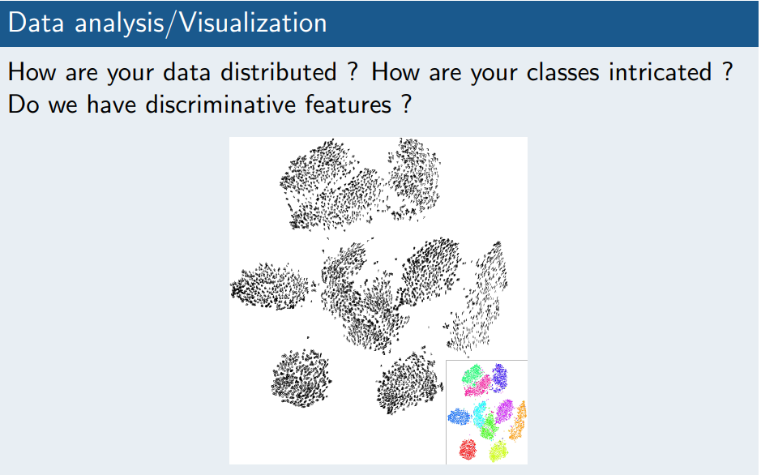
Dimensionality reduction: why ?

Slide 17
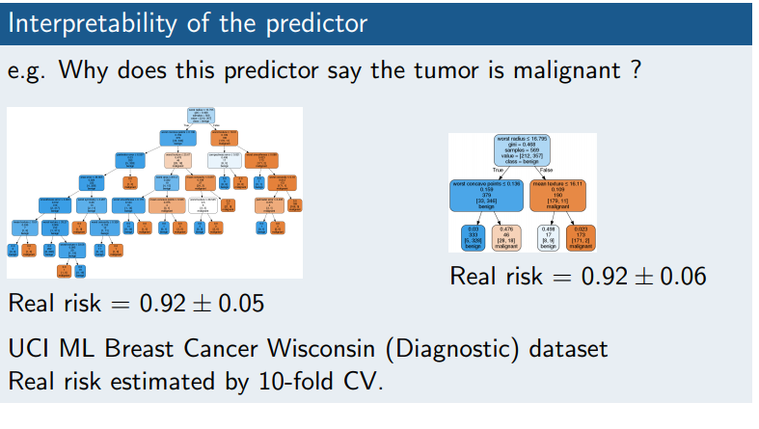
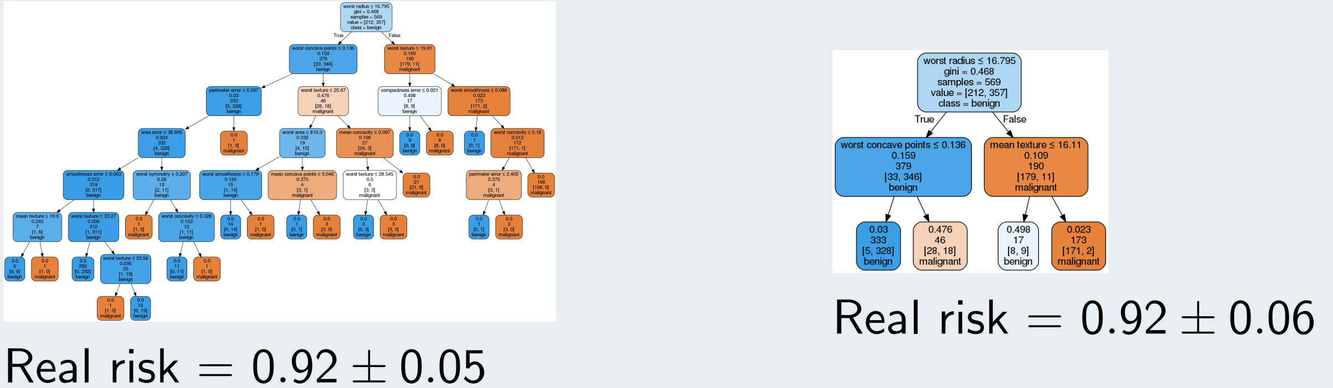
Dimensionality reduction: why ?

Slide 18
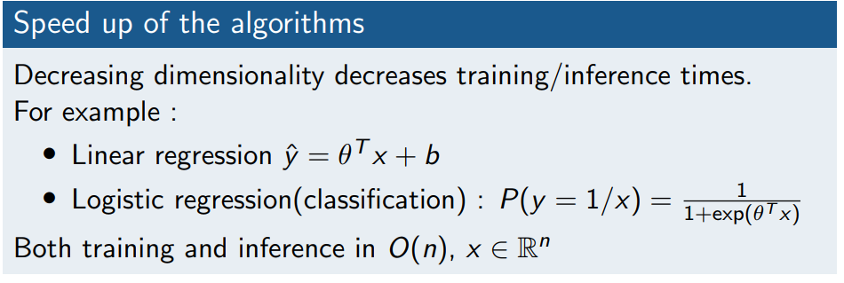
Dimensionality reduction: why ?

Slide 19
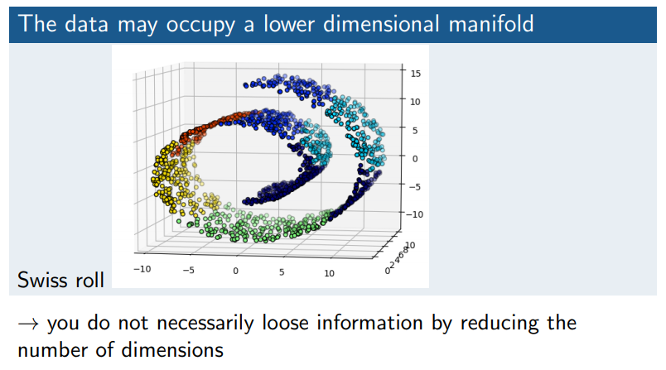
Dimensionality reduction: why ?

Slide 20
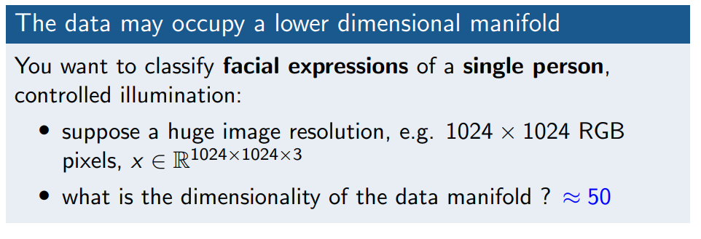

Dimensionality reduction: why ?

Slide 21
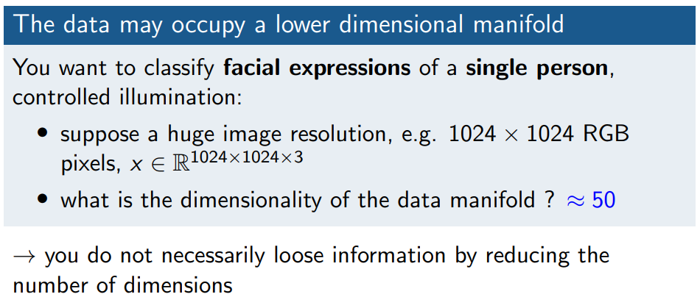
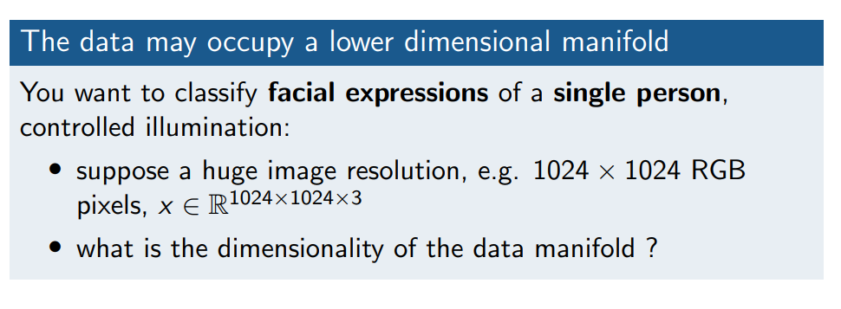
Dimensionality reduction: why ?

Slide 22
Dimensionality reduction: why ?

Slide 23
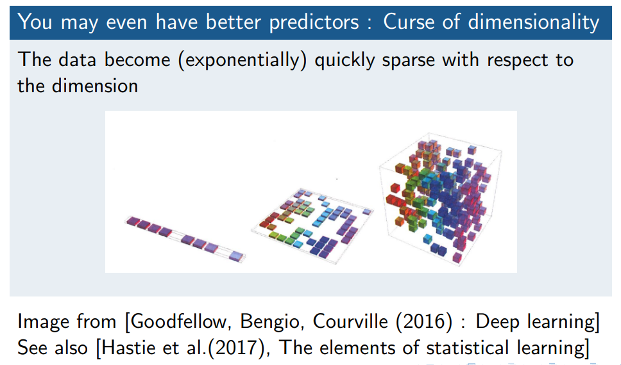
Dimensionality reduction: why ?

Slide 24
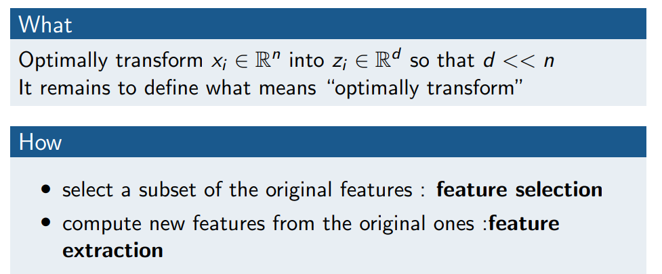
Dimensionality reduction : what/why/how ?

Slide 25
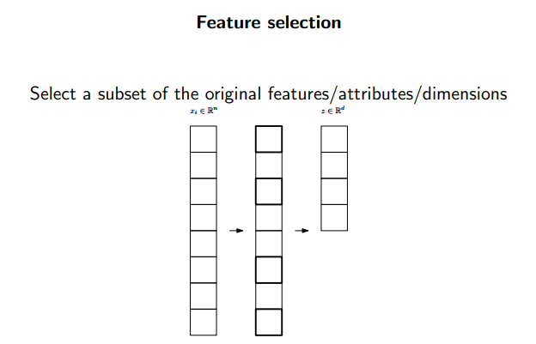
Dimensionality reduction : what/why/how ?

Slide 26
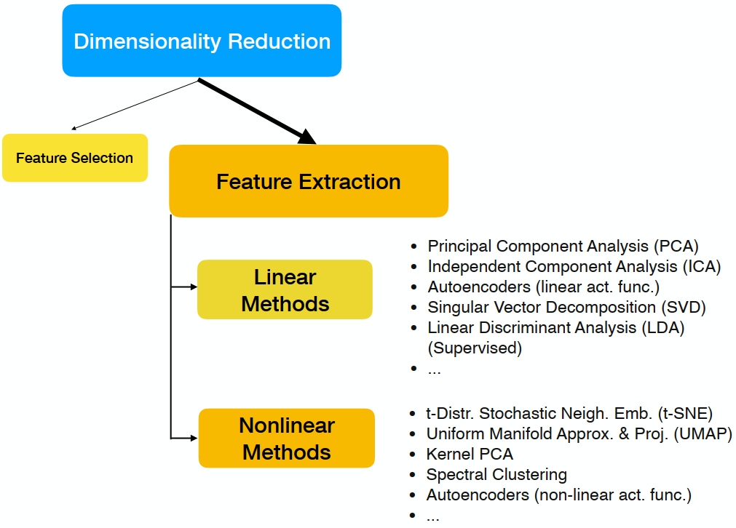
Learning？

Slide 27
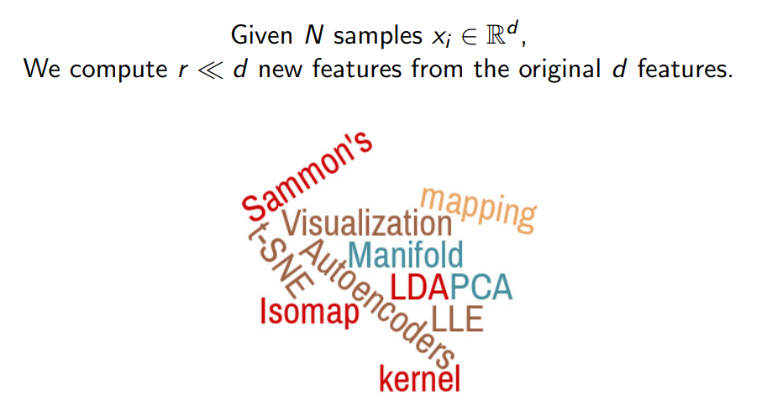
Feature extraction

Slide 28
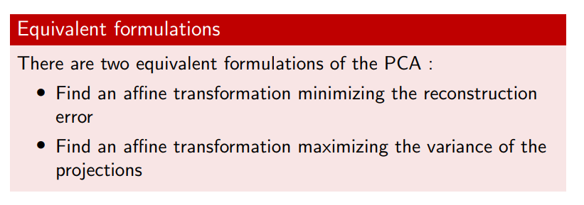
Principal Component Analysis (PCA)

Slide 29
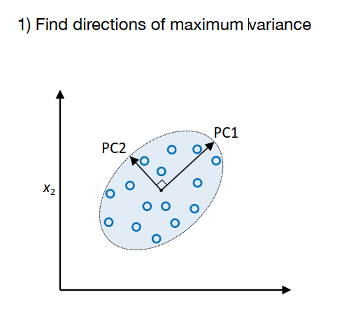
Principal Component Analysis (PCA)
Find an affine transformation of the data minimizing the reconstruction error

Slide 30
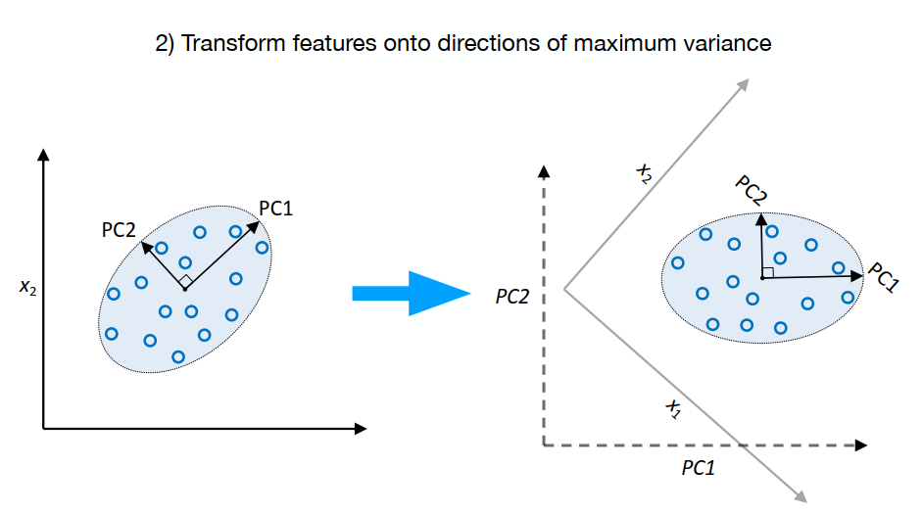
Principal Component Analysis (PCA)

Slide 31
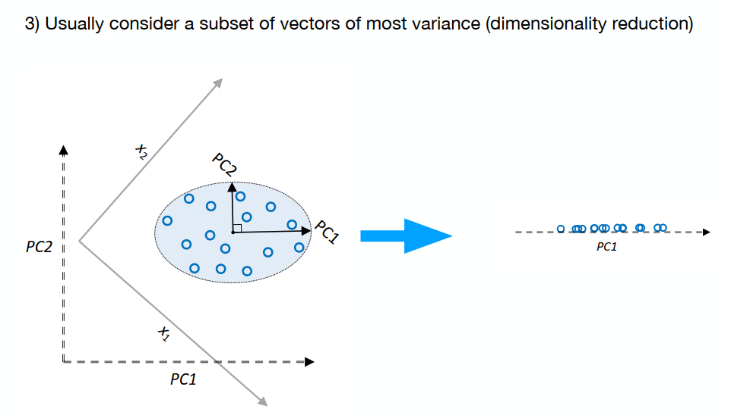
Principal Component Analysis (PCA)

Slide 32
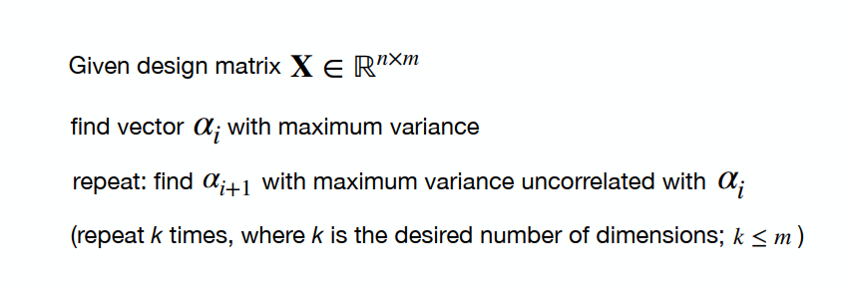
Principal Component Analysis (PCA)

Slide 33
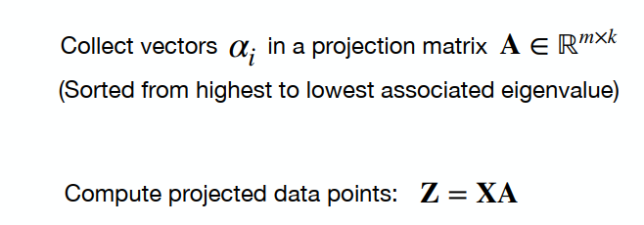
Principal Component Analysis (PCA)
Two approaches to solve PCA (on standardized data):
1. Constrained maximization (e.g., Lagrange multipliers)
2. Eigen-decomposition of covariance matrix directly

Slide 34
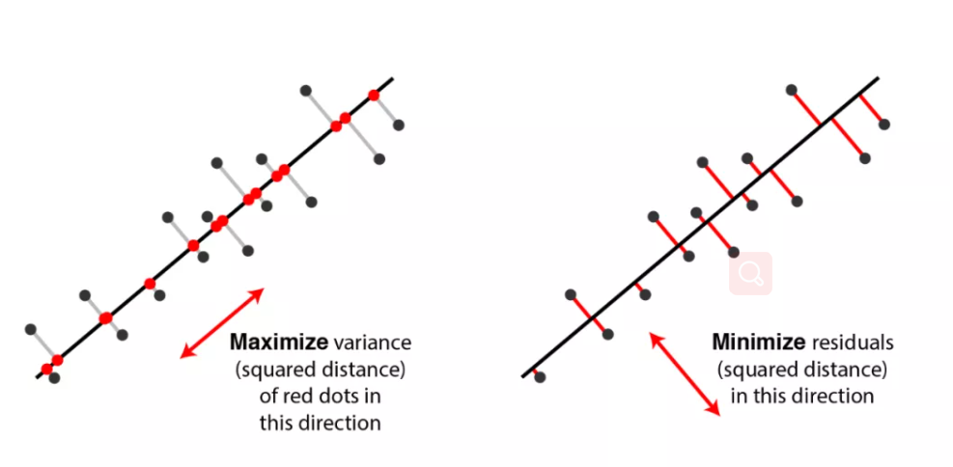

Slide 35
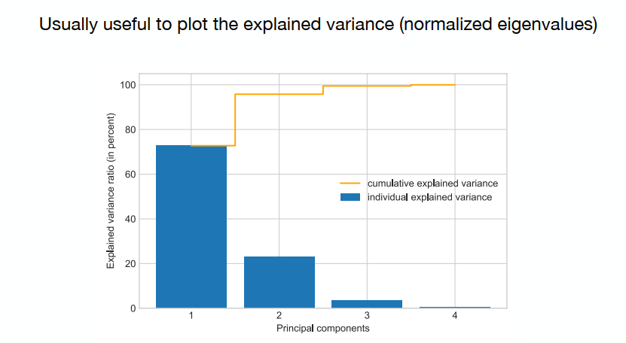
Principal Component Analysis (PCA)

Slide 36
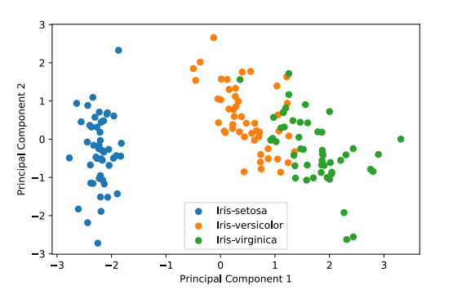
Principal Component Analysis (PCA)
Keep in mind that PCA is unsupervised!

Slide 37
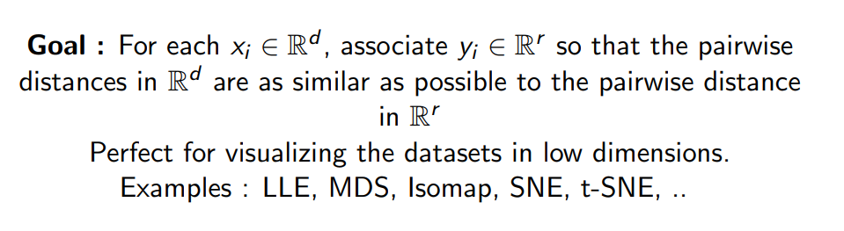
Feature extraction : Manifold learning
Nearby point remain nearby
Distant points remain distant

Slide 38
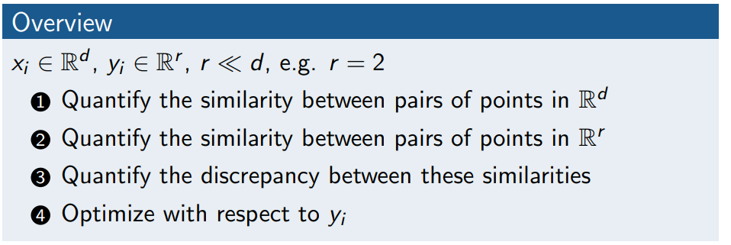
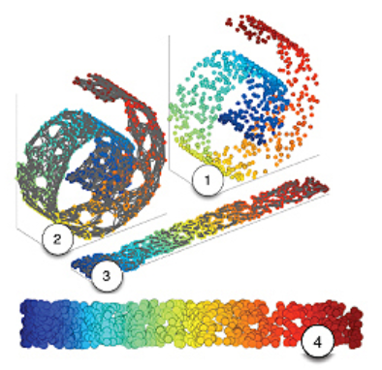
Manifold learning

Slide 39
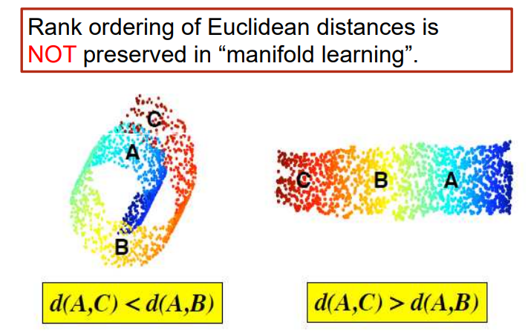
Manifold learning

Slide 40
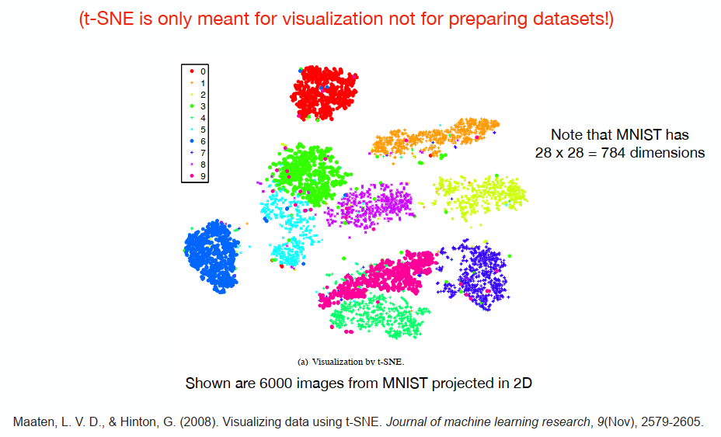
t-Distributed Stochastic Neighbor Embedding (t-SNE)

Slide 42
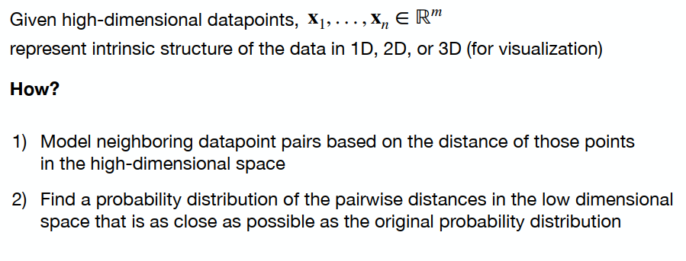
t-Distributed Stochastic Neighbor Embedding (t-SNE)
Main Idea: Map points near on a manifold to a near position in low-dimensional space

Slide 43
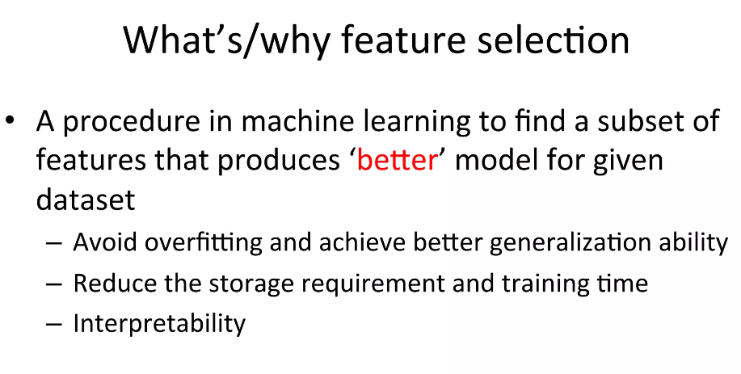
Feature selection

Slide 44
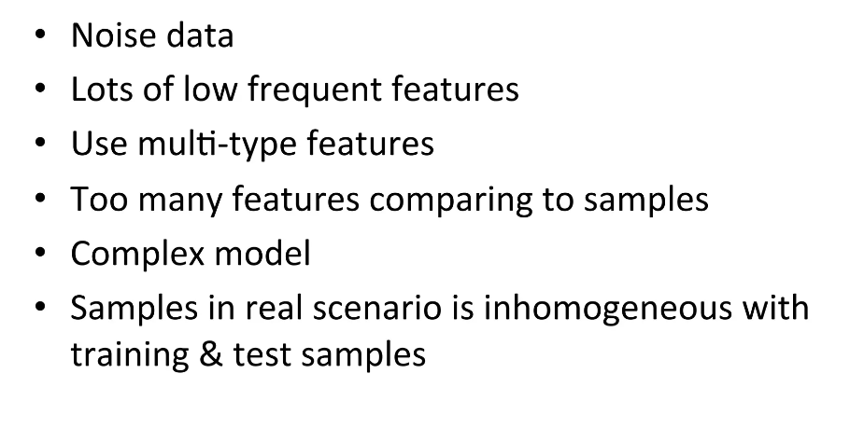
When feature selection is important

Slide 45
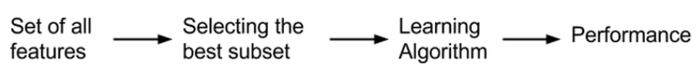
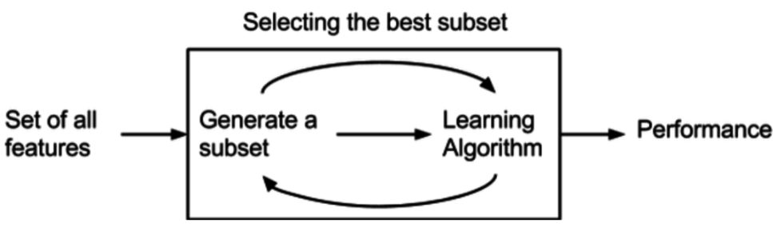
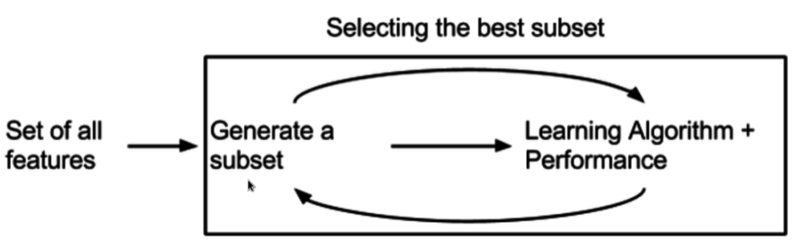
包裹法(Wrapper)
嵌入法(Embedded)

Slide 46
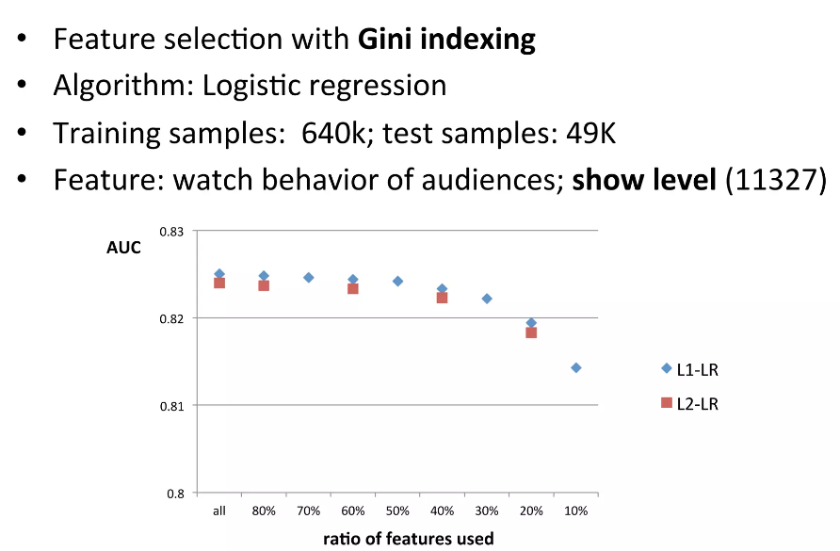
When No.(samples)/No.(feature) is large

Slide 47

When No(samples) equals to No(feature)

Slide 48

Typical methods for feature selection

Slide 49

Single feature evaluation

Slide 50

Frequency based

Slide 51

Mutual information

Slide 52

Chi Square Statistic

Slide 53

Entropy

Slide 54

Information Gain

Slide 55

KL divergence

Slide 56

Gini indexing

Slide 57

Shortages of single feature evaluation

Slide 58

Shortages of single feature evaluation

Slide 59

Shortages of single feature evaluation

Slide 60

Subset selection methods

Slide 61


Slide 62

Wrapper methods for logistic regression

Slide 63


Slide 64


Slide 65

Embedded feature selection

Slide 66

Embedded feature selection

